Slide 1

The Battle of Neighborhoods in Scarborough, Toronto
IBM Capstone project.

Slide 2
Methodology
Recommender System
Machine learning
Exploratory analysis
Inferential analysis

Slide 3
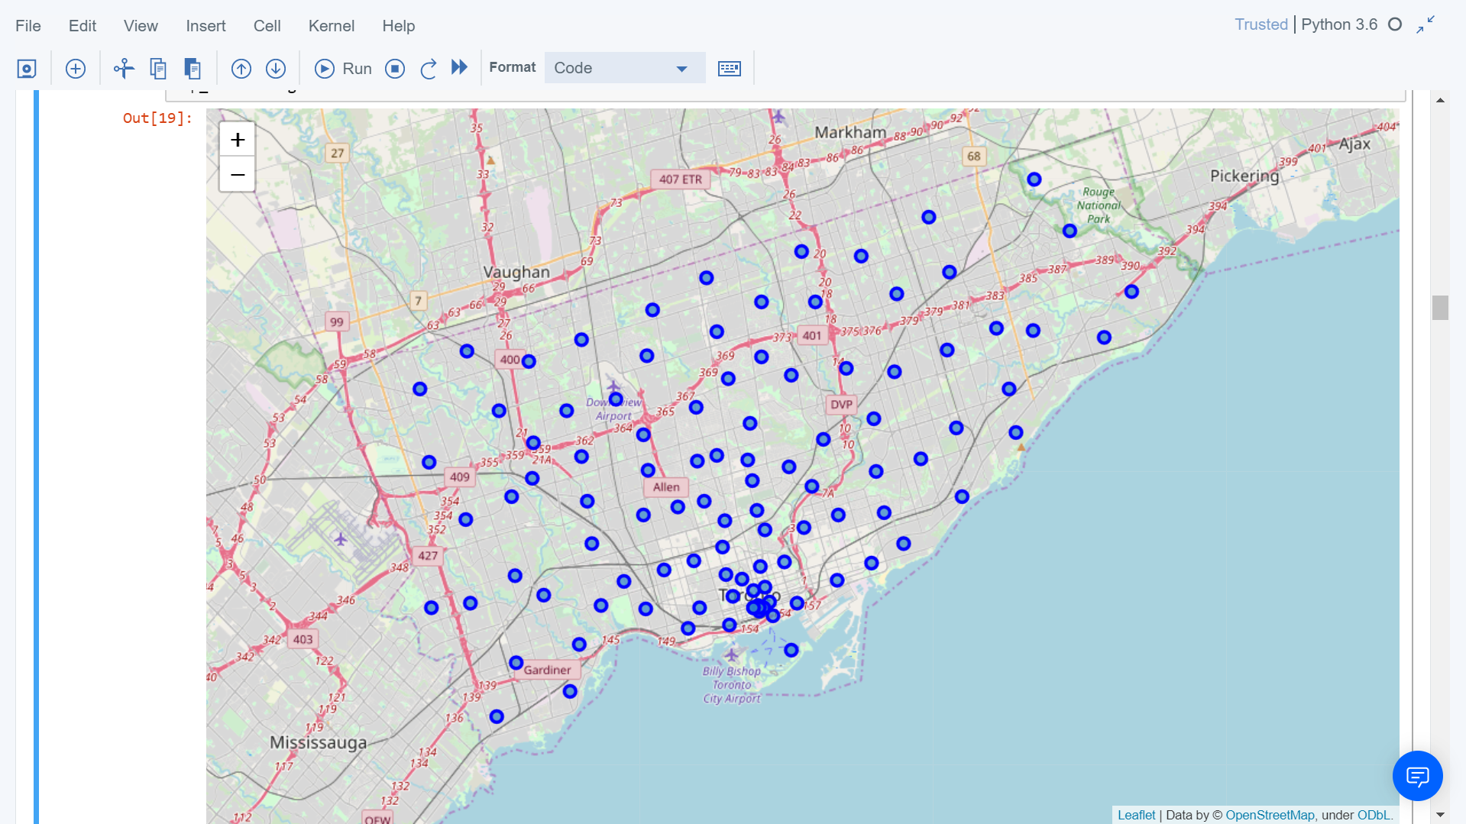
Map of Scarborough

Slide 4
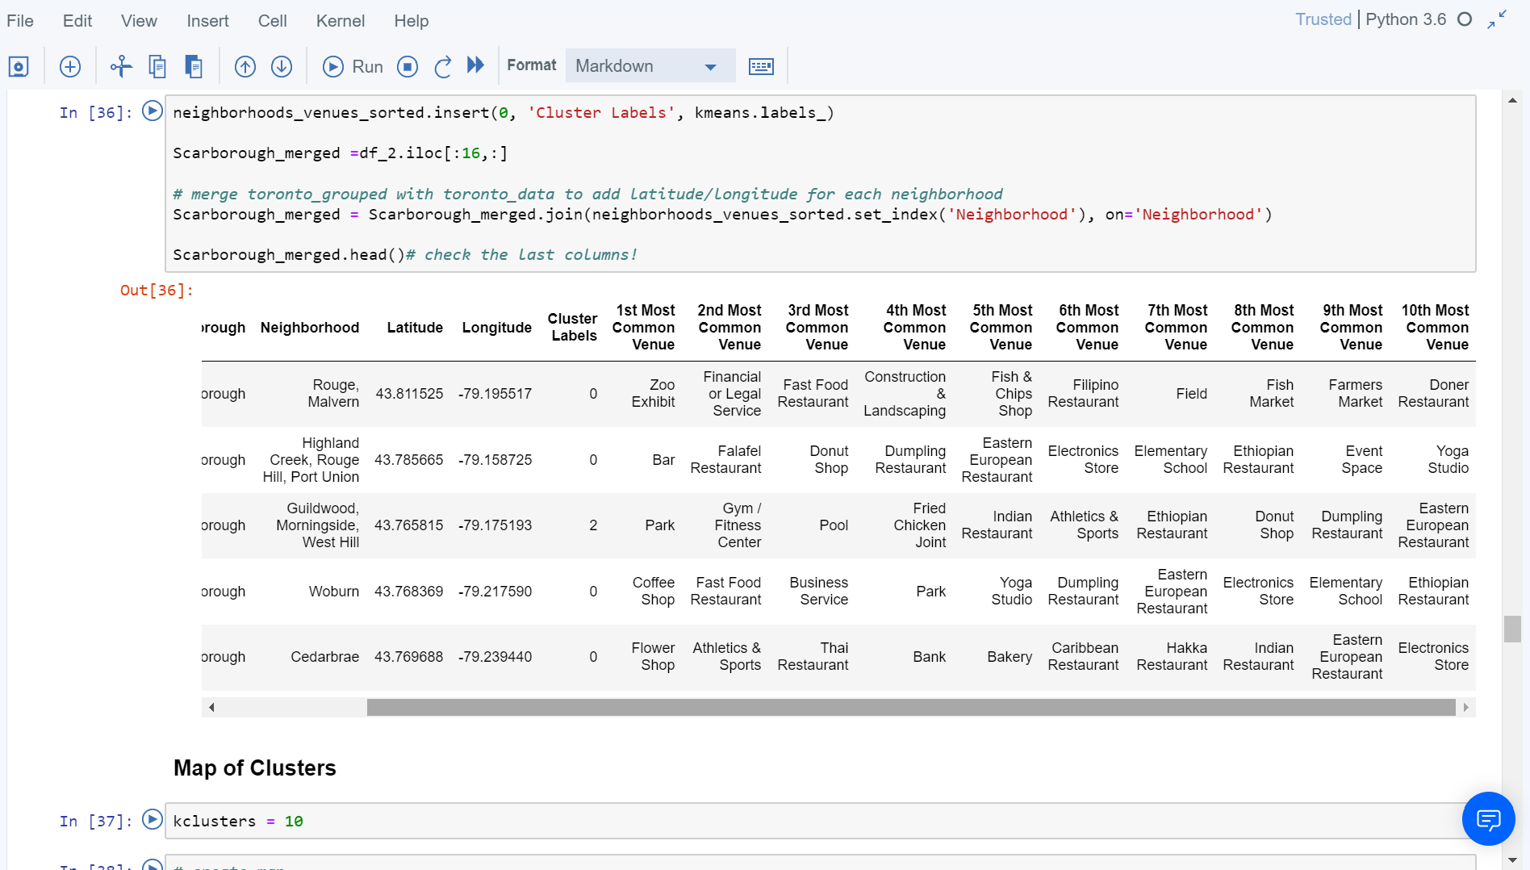
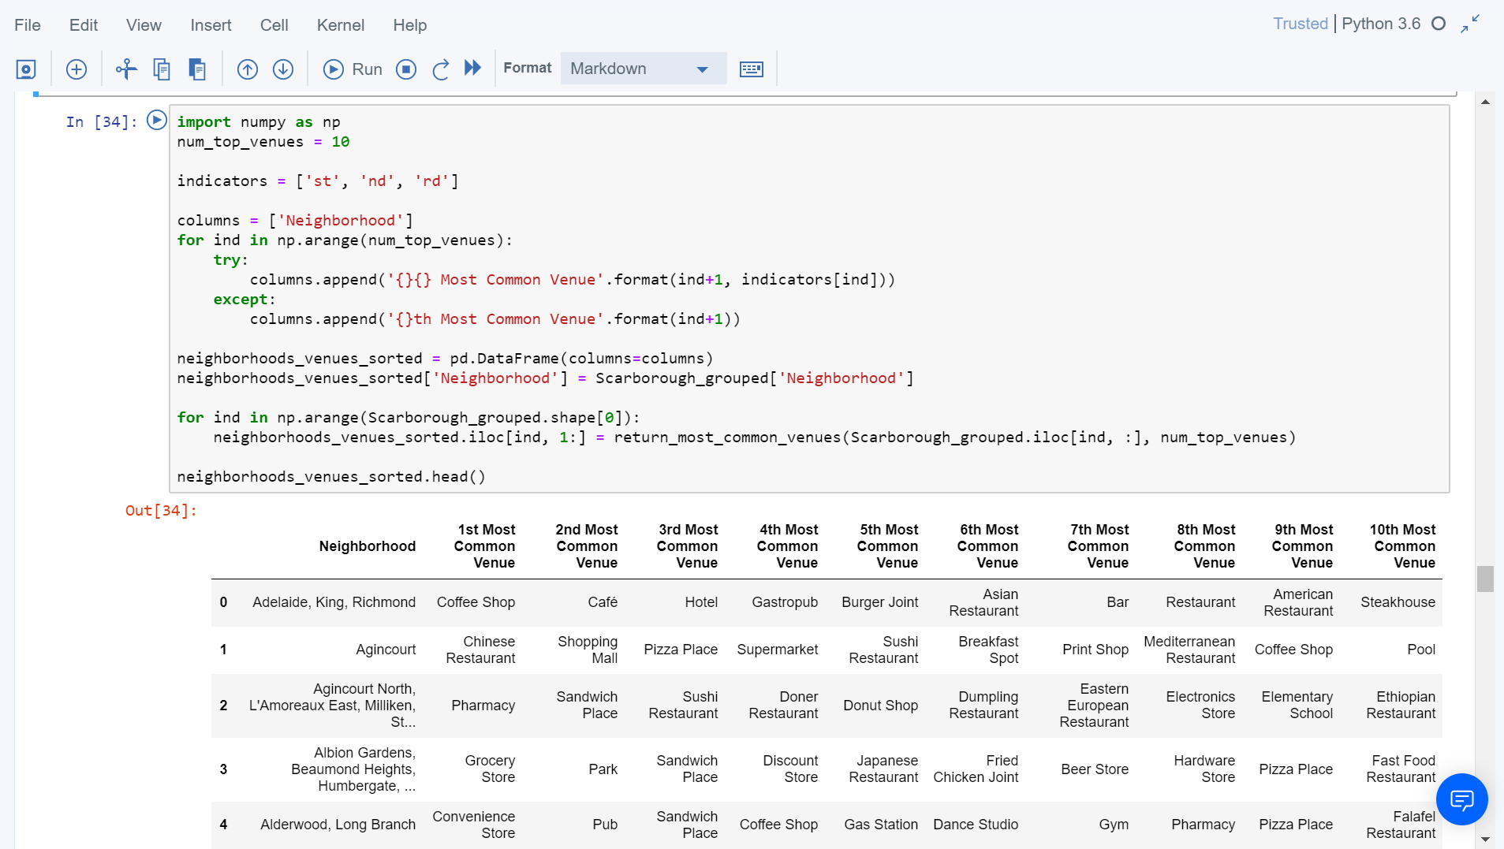
Datasets

Slide 5
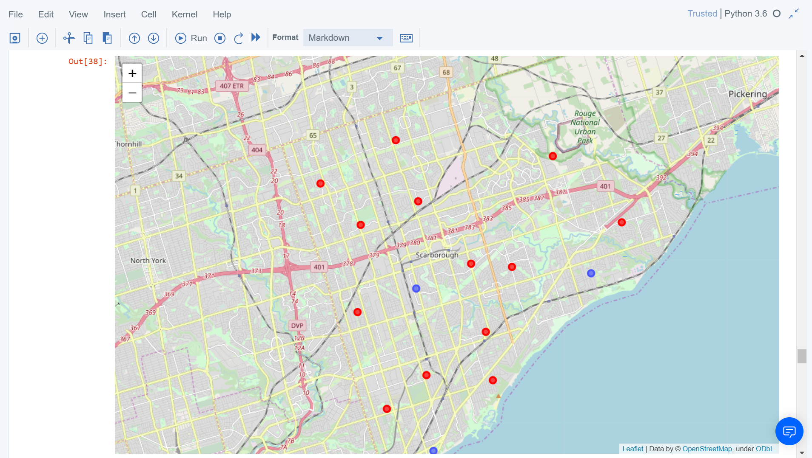
Results and conclusion

Slide 6

Thank You!

